Slide 1
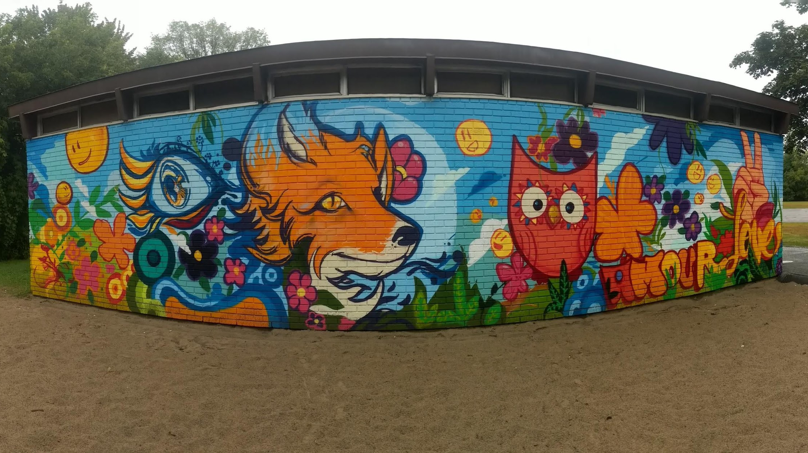
Queensway Terrace North Community Association
Annual General Meeting - October 4, 2023

Slide 2
Agenda
Community Discussion
Traffic and Safety in QTN
Q and A with Councillor Kavanagh
Community Priorities
Business Meeting for QTNca
Board Report
Financial report
Board nominations
Questions for QTNCA Board

Slide 3
What we have heard
Speeding continues to be a major concern within QTN
Limited compliance with new 30 km/h limit
Complaints have decreased on Kelly/Neville with the installation of speed humps, but increased on Clarenda
In parts of QTN with significant infill development, street parking is becoming more contentious
Crossing Carling remains slow and unpleasant for pedestrians and cyclists
The condition of local streets is poor and gets worse after every infill

Slide 4
Q&A with
Councillor Kavanagh

Slide 5
Councillor Theresa Kavanagh
http://www.baywardbulletin.ca
BayWard@ottawa.ca

Slide 6
Community Priorities

Slide 7
QTNCA Business Meeting

Slide 8
2022-2023 Board of Directors
Executive
Directors
Kathy Vandergrift, President
Annette Dillon, Vice President
Lija Bickis, Secretary
Jill Skinner, Treasurer
Gerald Gaugl
Jessica Dawson
Masuma Rustamzada
Susan Blakeney

Slide 9
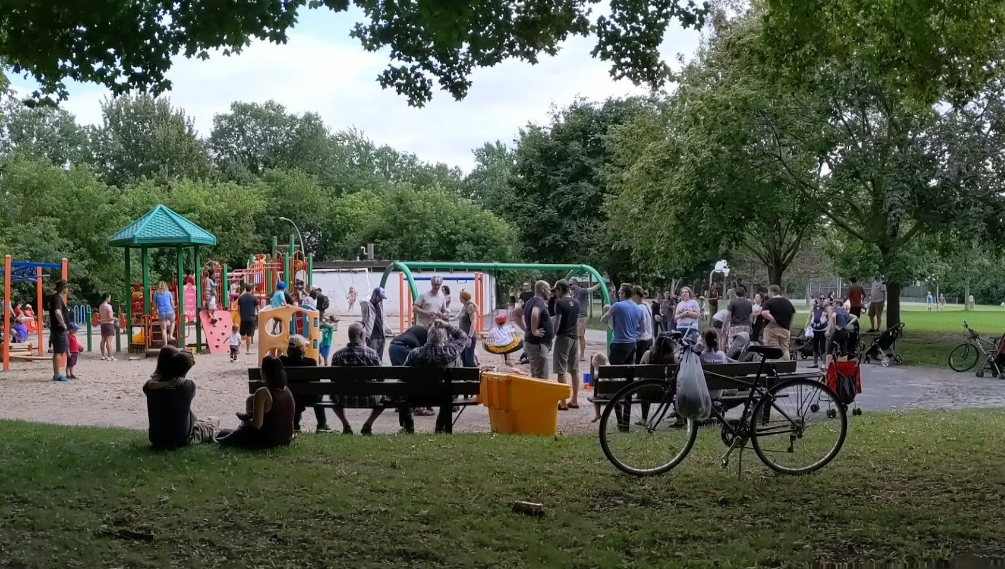
Events

Slide 10
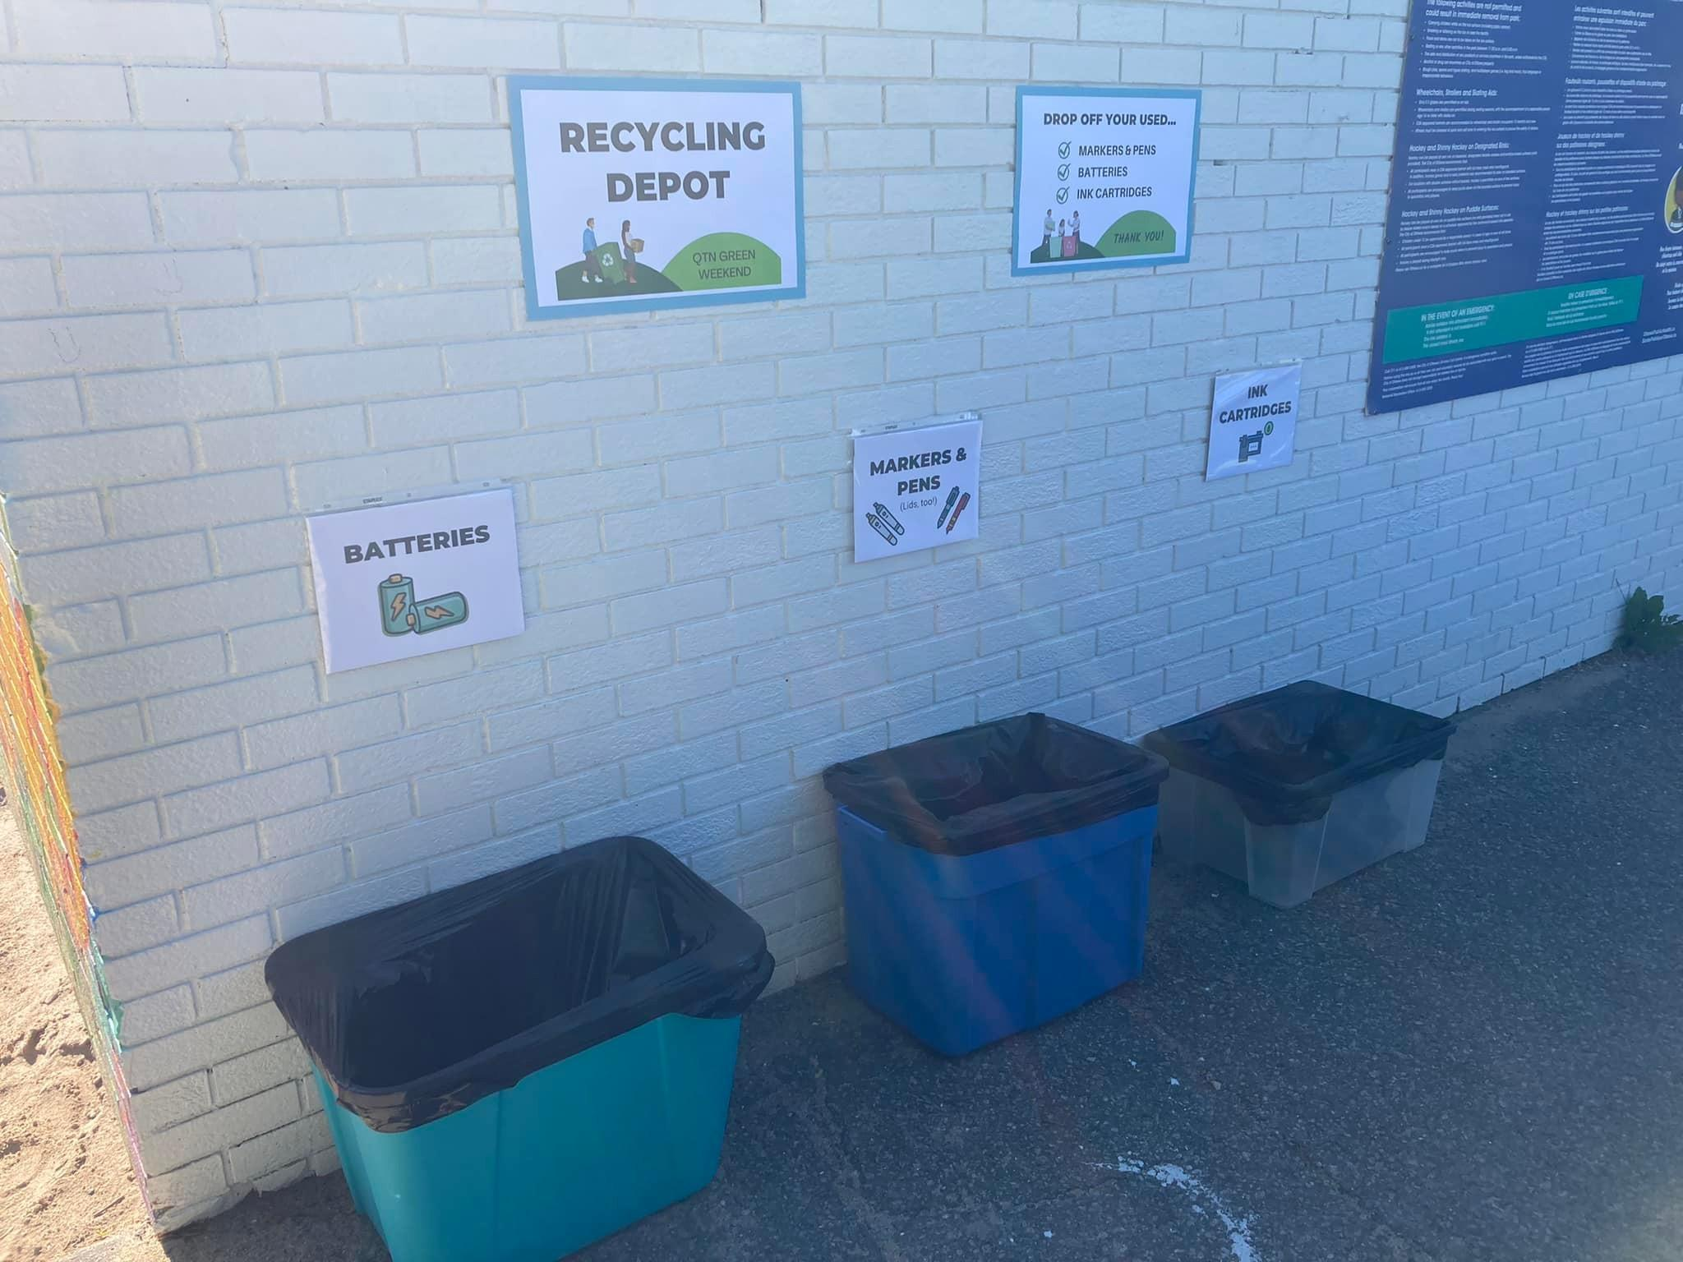
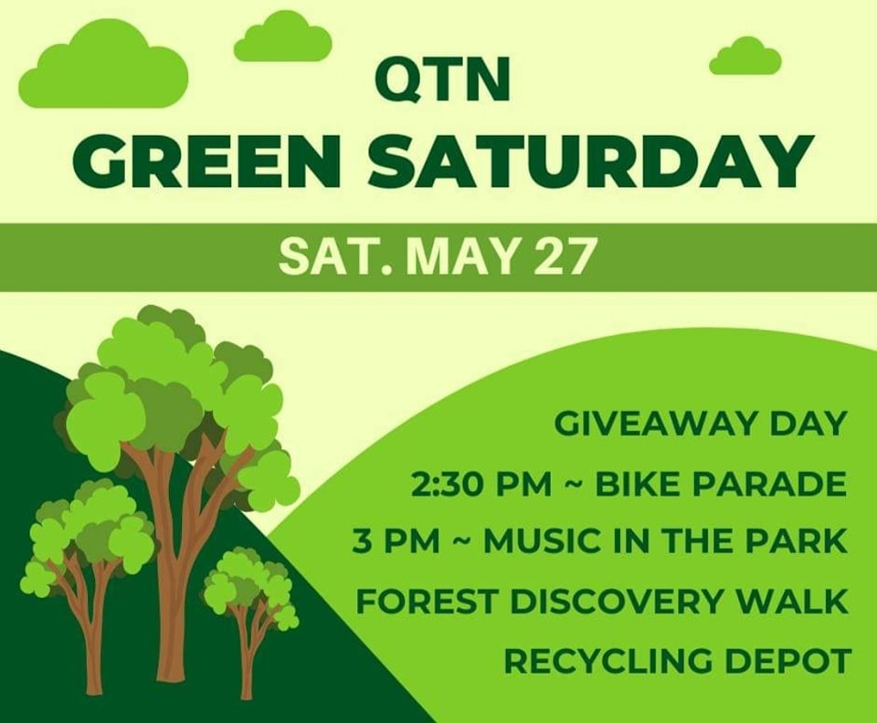
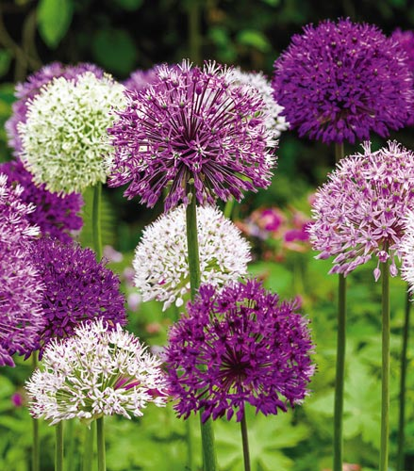
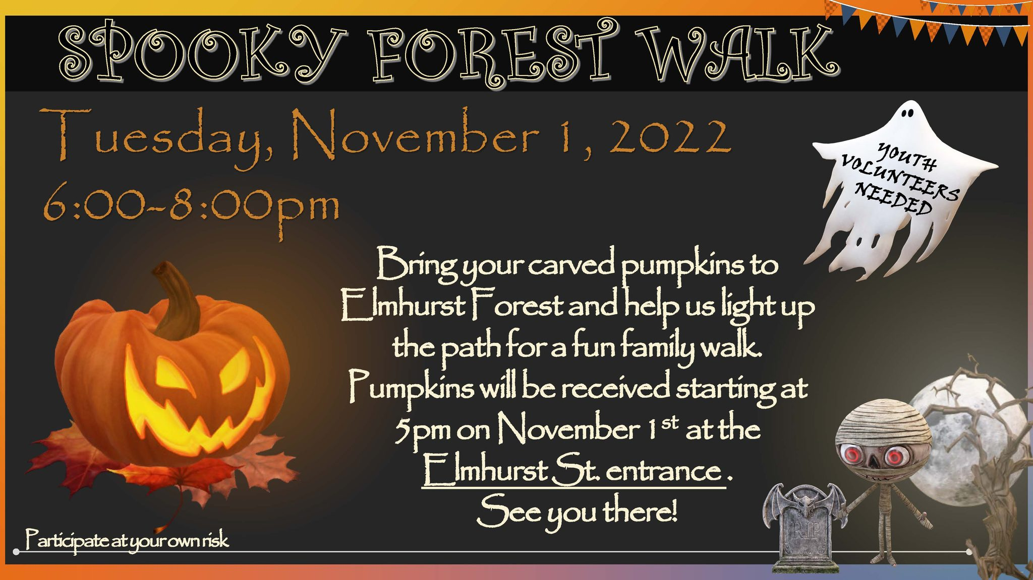
HIGHLIGHTS…
Halloween
Community Candidate meeting
Holiday Events
Forest Fairy Lights
Caroling
Winter CarnivalP
Community-Wide Yard Sale
Green Weekend
Music in the Park
Bike Parade
Spring Plant Share
Special Event: Children's Mental Health and Wellness
2022-2023 EVENTS

Slide 11
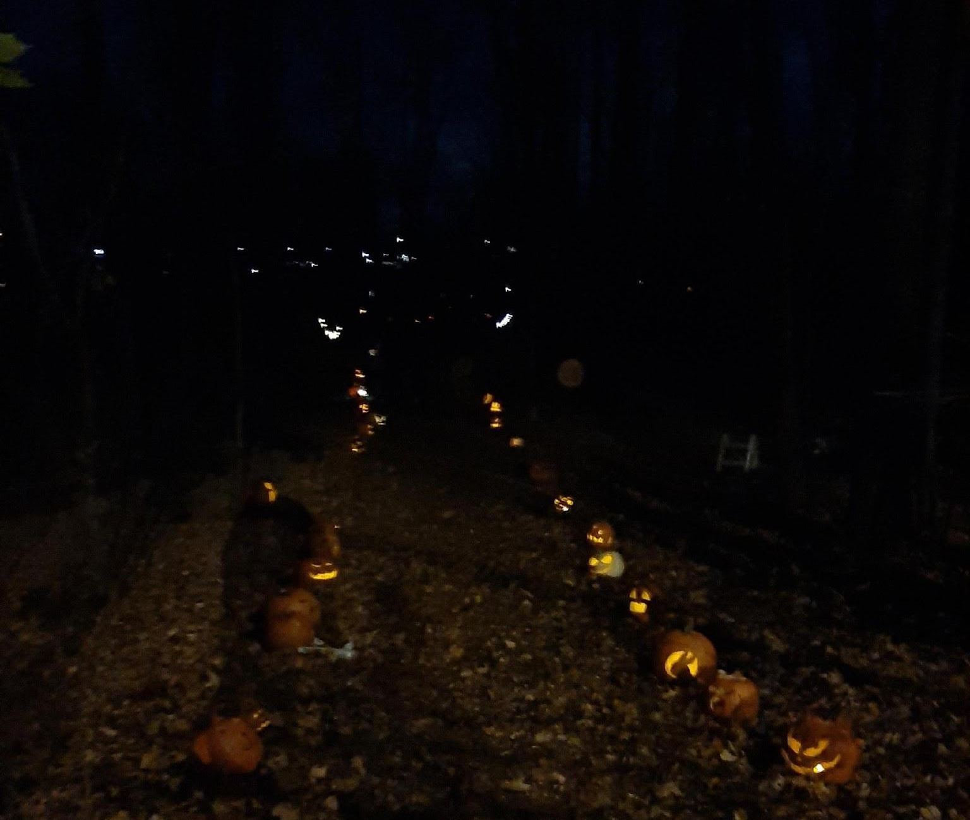
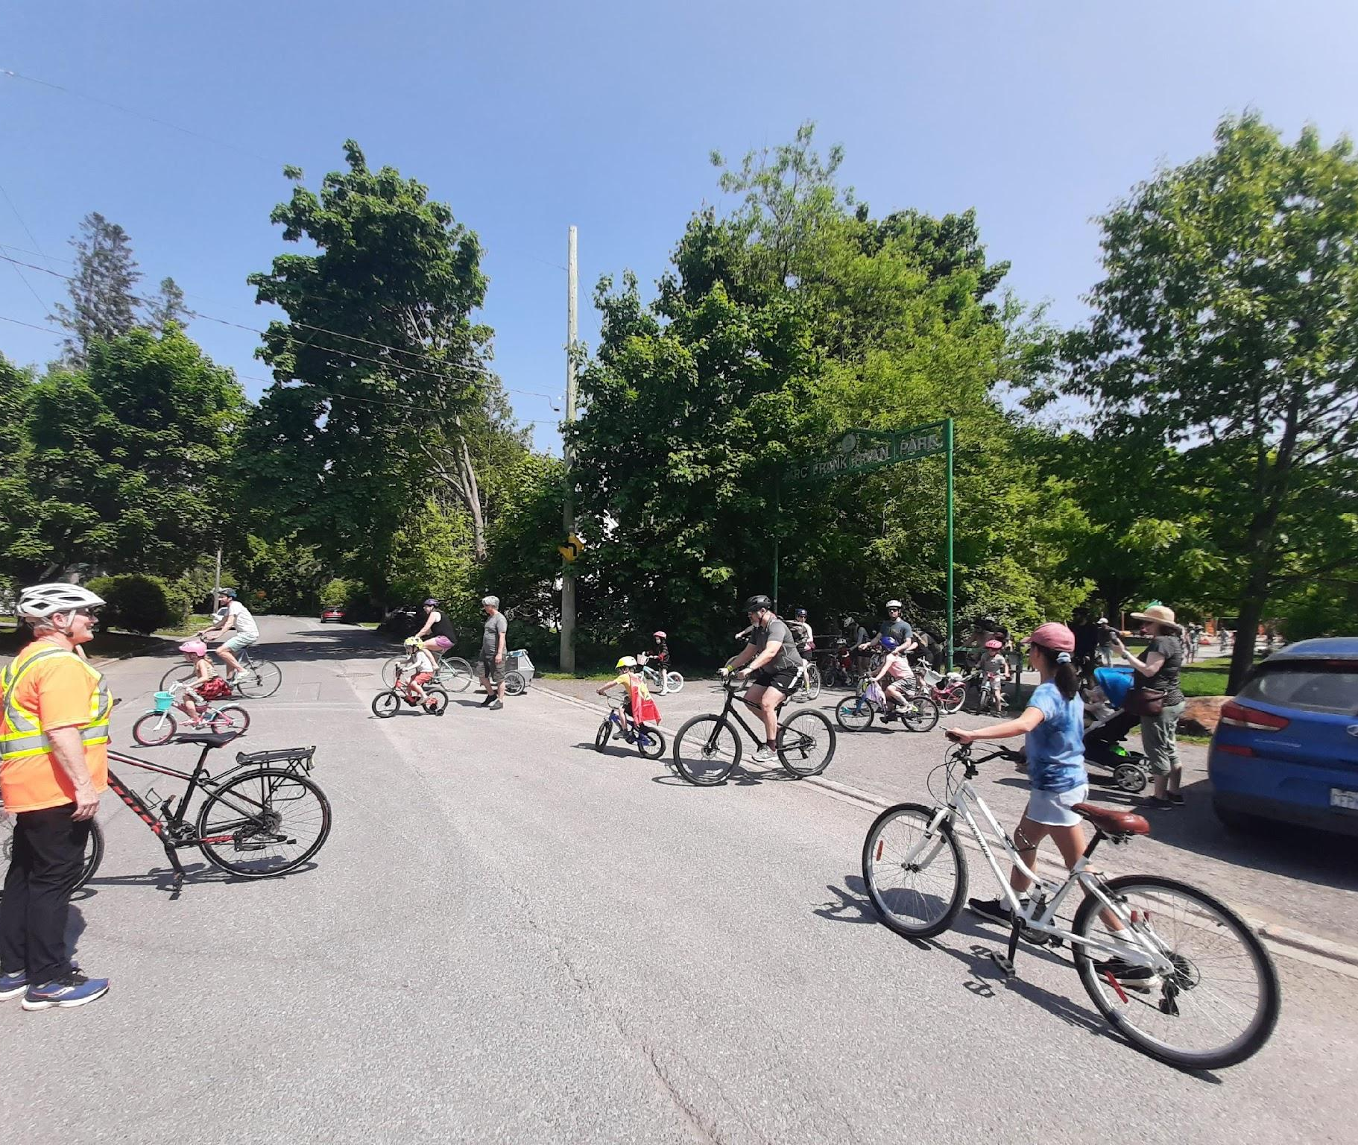
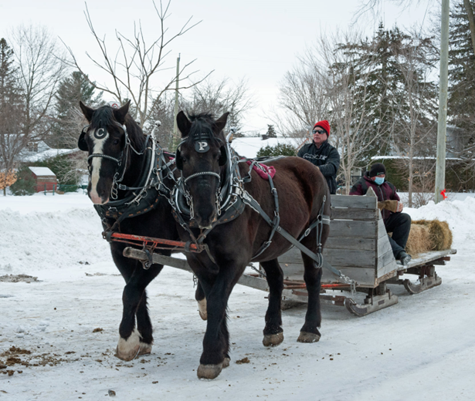
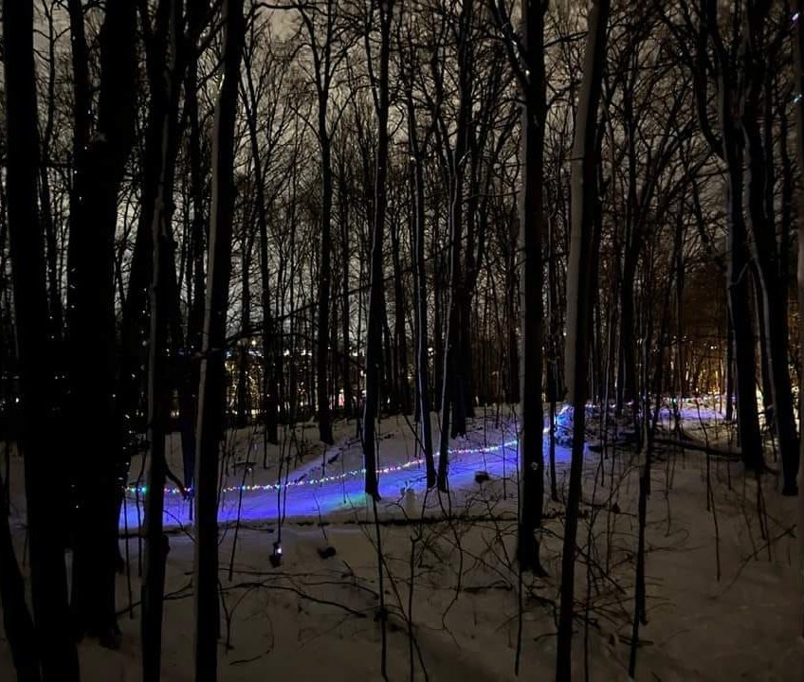

Slide 12
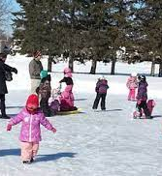
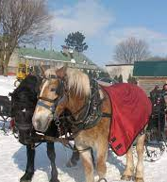
COMING SOON…
Pumpkin Contest
Hallowe’en forest walk
Holiday Caroling
Frank Ryan Park rink
Winter Carnival (4 February)
Spring Events

Slide 13
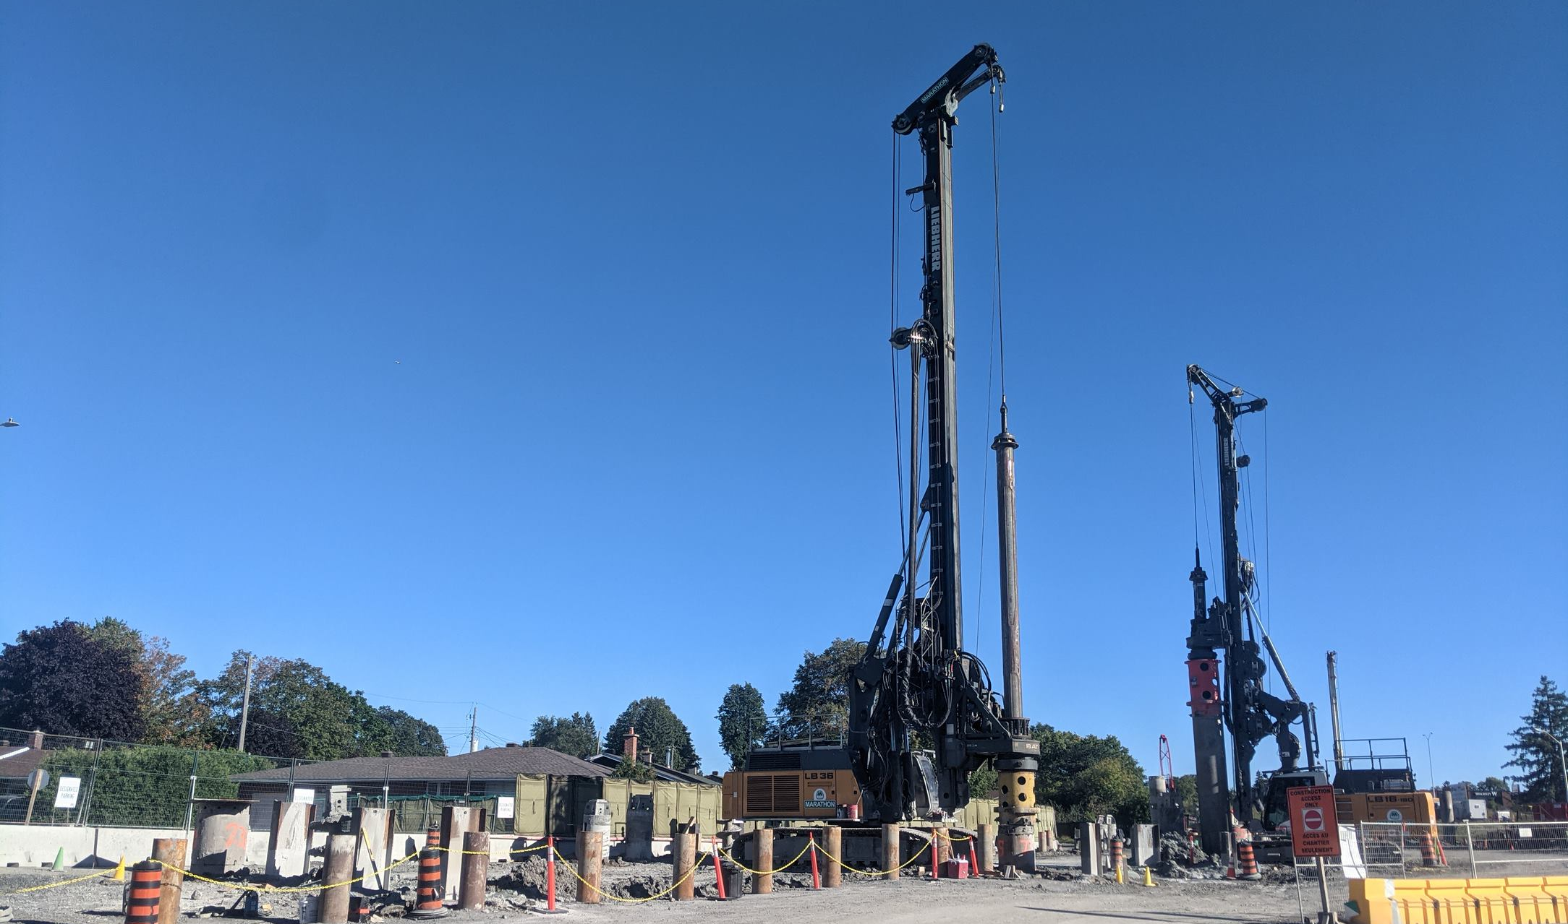
Planning and Road Safety

Slide 14
Planning Committee
Some Progress
Accessible Path to Frank Ryan Park from Clarenda
Advocacy to improve Committee of Adjustment process
Continuing advocacy on in-fill housing to fit in QTN
Progress toward new fieldhouse in Frank Ryan Park
Delays in two secondary plans is a concern. Continuing advocacy on related issues.
Pinecrest/Queensview Secondary Plan which includes QTN
Lincoln Fields Secondary Plan
Coming later this fall; limited time for public review and input

Slide 15
Transportation Committee
Transportation Planning
Pinecrest Traffic Study - QTNCA advocated for it -in PQ plan
Traffic study to improve Carling-Connaught and Parkway access
Speed reduction and safety - speed humps coming on Alpine Avenue
Advocacy for paths, biking, and sidewalks (Connaught Avenue Sidewalk approved) to connect to nearby neighbourhoods and amenities
Asking residents to comment on Queensview cycling plan
Parking Policies
LRT-related Issues
Improved response to construction noise through direct KEV contact
City noise policies need updating
Landscaping plans for Connaught Park area
City needs to work on optimizing construction schedule to minimize major disruptions to individual neighbourhoods
QTN will have construction impacts for the whole of Phase 2

Slide 16
Natural Environment

Slide 17
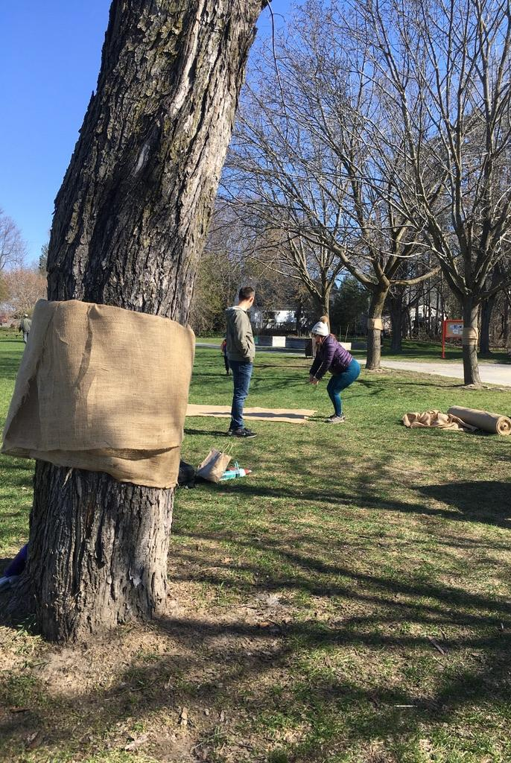
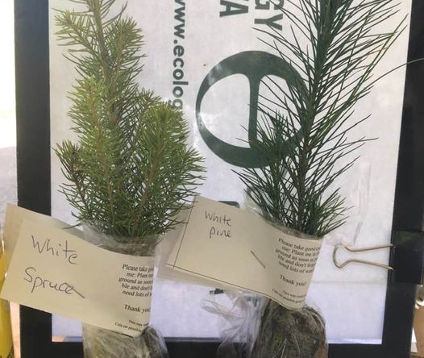
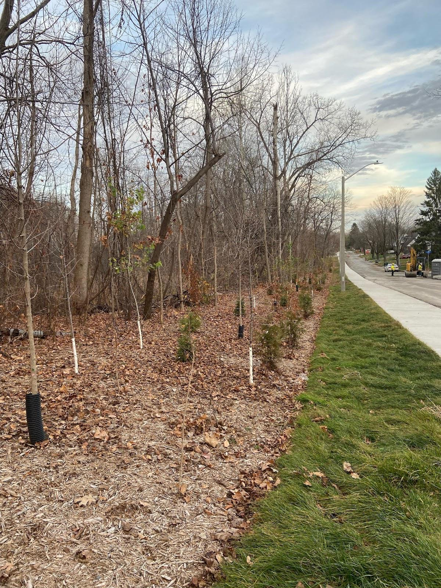
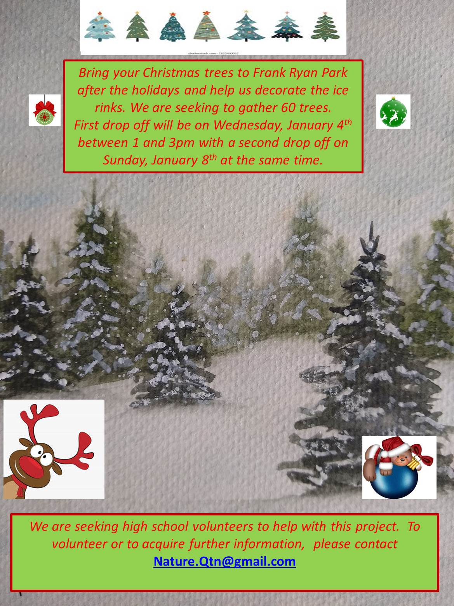
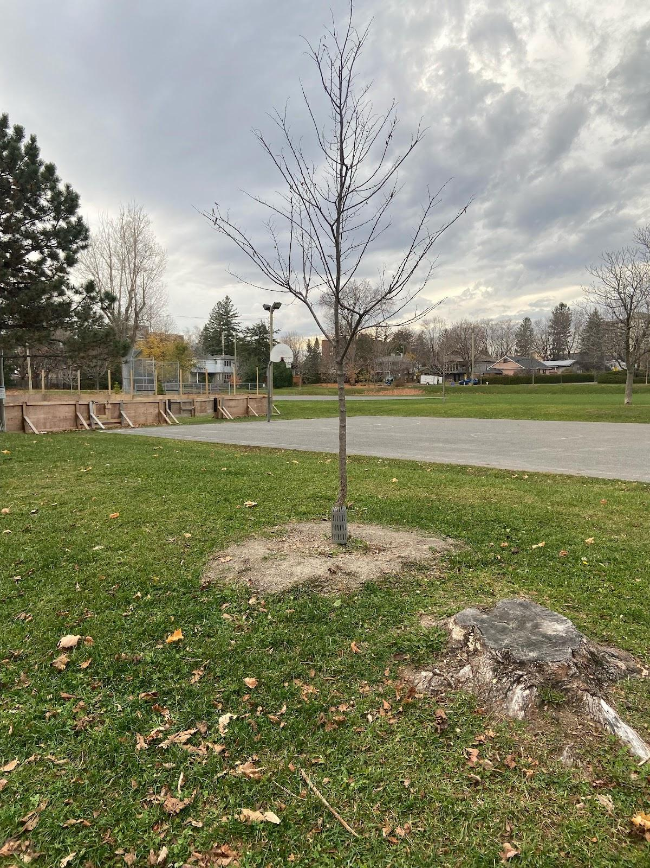
Natural Environment
Canopy regeneration project, tree replacements for Alpine sewer project
Tree giveaway with Ecology Ottawa
Christmas tree reuse for the Frank Ryan Park rink
Tree replacement at Frank Ryan

Slide 19
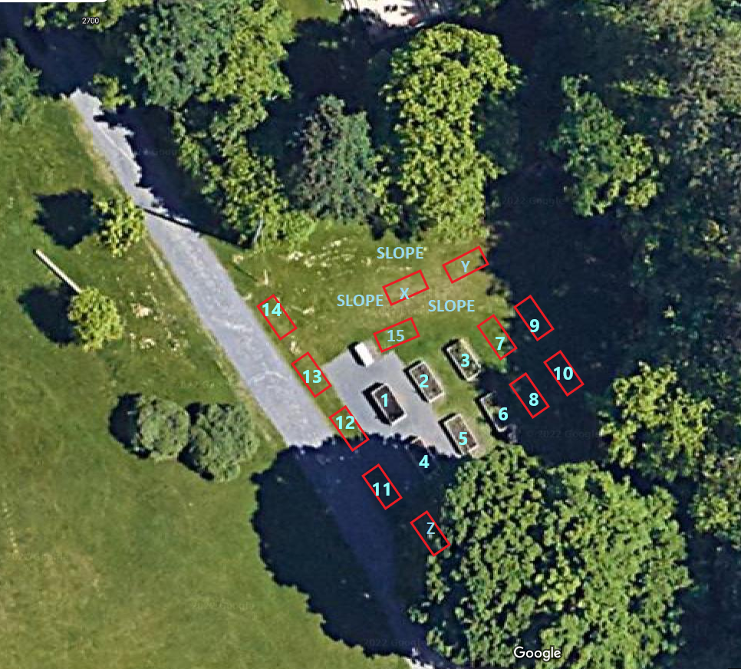
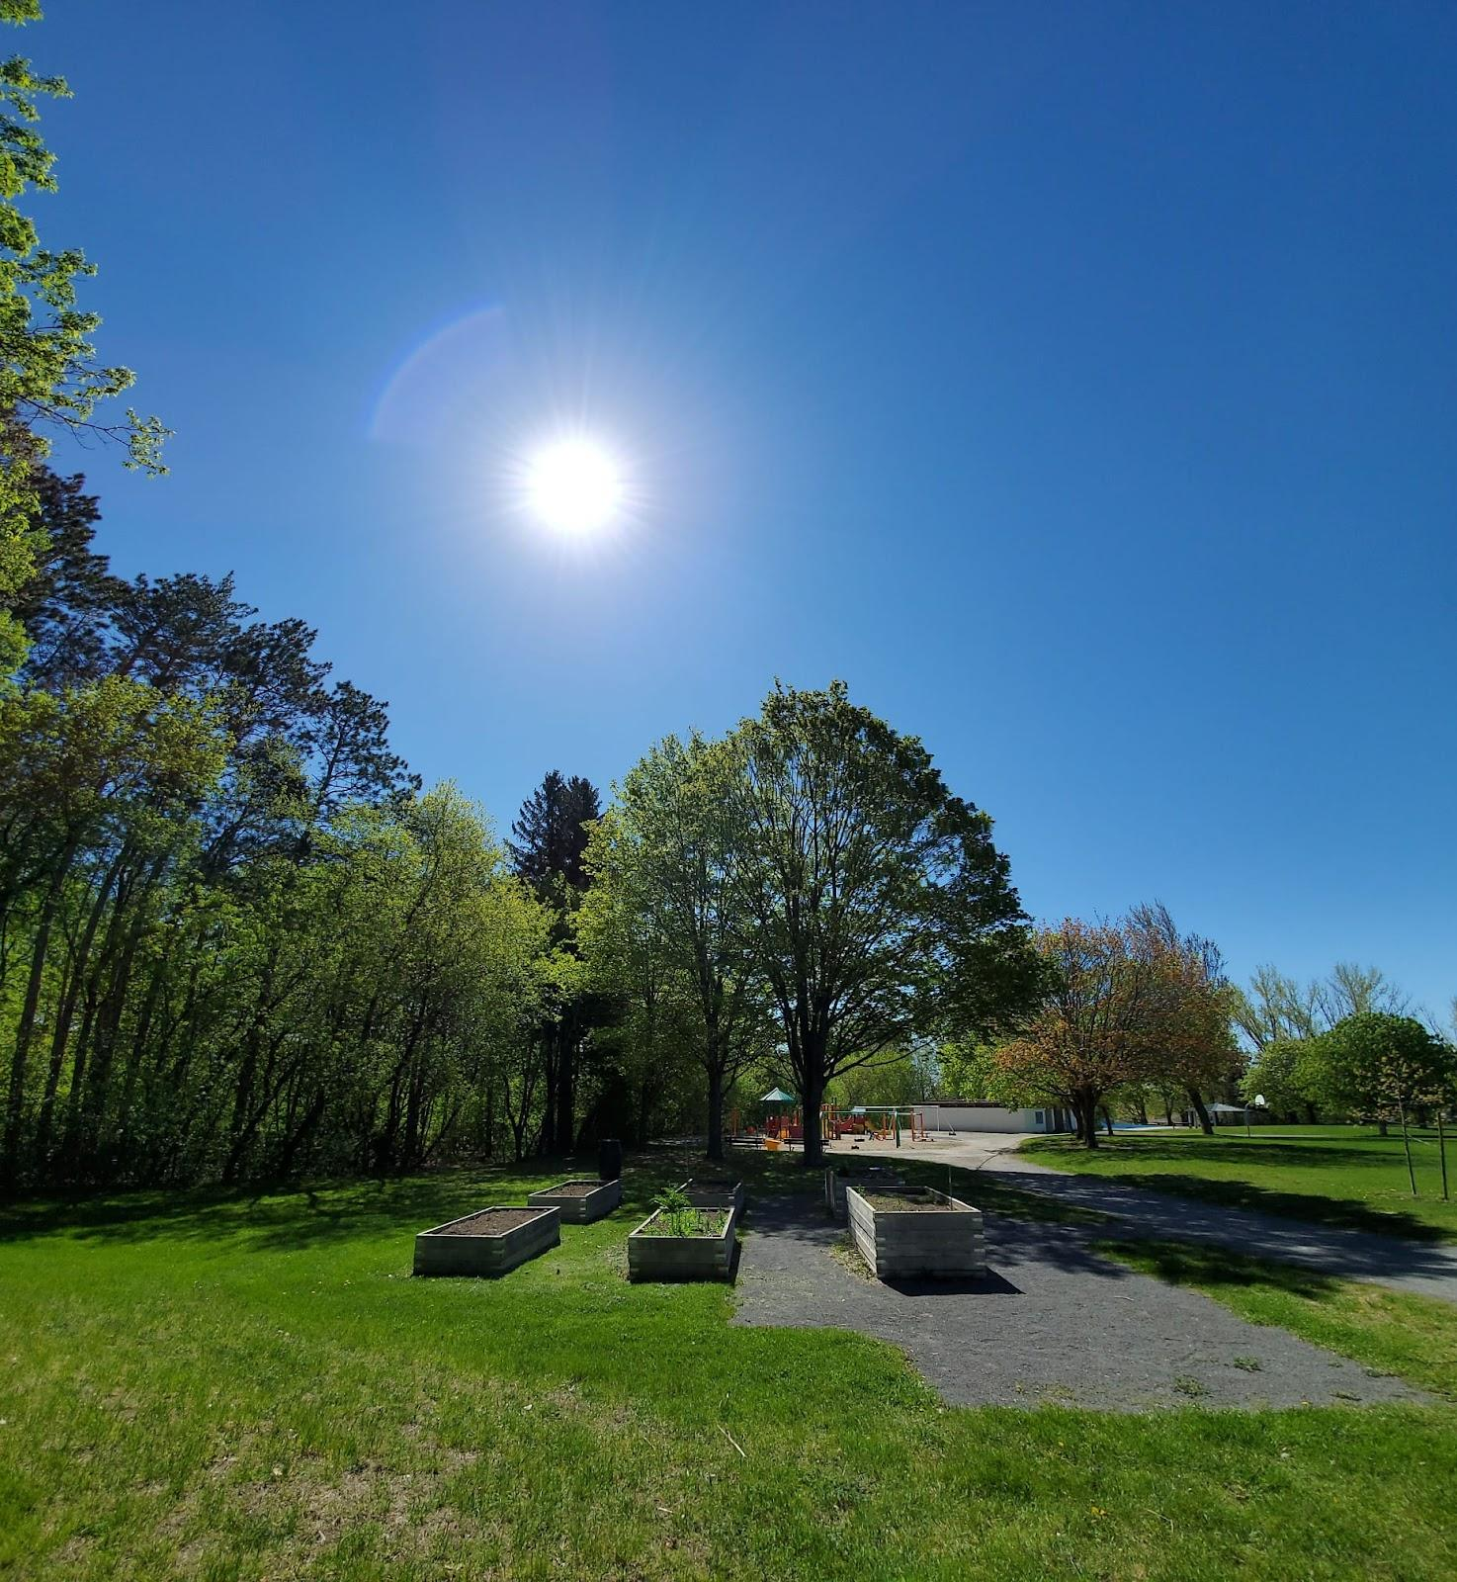
QTN Community Garden
established in 2015
6 boxes available for seasonal use by individual gardeners
New signs installed to help explain the purpose
Continuing to work on the addition of garden boxes into existing area (under review)
Overlapping uses in the park make expansion difficult
Sloping terrain is also a challenge

Slide 20
Financial Update
Opening balance: $8,013.28 (Nov 2022)
Closing balance: $7,758.11 (Sep 2023)
Revenue: $5,989.85 (Primarily through rink contract)
Major expenses:
Rink $4,400 ( $4,050)
Events $955.85 ( $1,282.13)
Admin $1,428.21 ( $92.18)
Detailed Statements are reviewed by Board Executive

Slide 21
Investments:
GICs TD Bank
1-Year $2,121.63 @4.25%
2-Year $2,660.98 @5.0%
3-Year $7,036.65 @4.5%
Detailed Statements are reviewed by Board Executive
Financial
Update

Slide 22
Election of New Board Members
Up to 14 board positions
2-year terms
4 members continuing for a second year
4 members up for renewal
Commitment:
Monthly meetings, 2 hours
Committee follow up (emails, coordination)
Notes:
1. Motion to endorse members who joined during the year and appoint them to a full-term:
The board recruited replacements to fill vacancies during the year, as provided in the bylaw, and now presents a motion to endorse and appoint these members for a full two-year term.
Motion: That the following members be appointed for a full two-year term:
Geoff Marlowe
Laura Krochmalnek
2. Motion to Appoint Members for another two-year term
The board appreciates the contributions of members who have completed one two-year term and nominates for renewal those who have expressed a willingness to serve another two-year term:
Motion: That the appointments of the following members be renewed for another two –year term:
Kathy Vandergrift
Jill Skinner
Caroline Beland-Pelletier
Gerry Gaugl
Masuma Rustamzada

Slide 23
Board Membership Motions
Motion: That the appointments of the following members be renewed for another two –year term:
Jill Skinner
Gerald Gaugl
Ma’suma Rustam-zade
Kathy Vandergrift
Motion: That the following QTN residents be appointed for a two-year term:
Jake Bradley
Sheila Powell
Brenda Snarr
Bruce Angle

Slide 24
Thank you to our volunteers!
Individual volunteers are too numerous to mention by name, but residents come out to help with:
Events
Planning committee
Environment committee
Rink management
Outreach (email and social media)
More volunteers are welcome! Please contact qtncommunity@gmail.com

Slide 25
Thank you
Contact us
qtncommunity@gmail.com

